Slide 1
WELCOME

Slide 2
Shout
Share
Guess
Participate

Slide 3
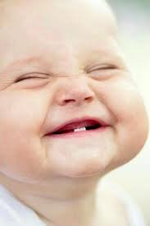

Slide 4

Imagine………

Slide 5



Slide 6
Name, Age & Locality
About Family/Background
Educational Qualification
My Aspiration/Goal
What You like to do/Hobbies
Achievements/Experience
Weakness
Strength

Slide 7
Why is English important?
Why does a student of CSE master on English language to explore his career?
Do you know any established professional in Bangladesh having poor oral performance in Eng?

Slide 8
First language
Business Language
Tourism
Official lang
Dialects
Flexible and changing

Slide 9
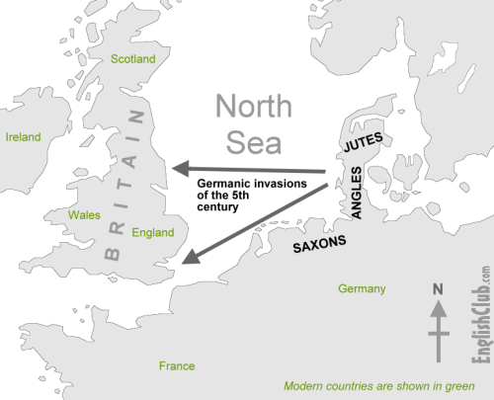

Slide 10


Slide 11


Slide 12


Slide 13
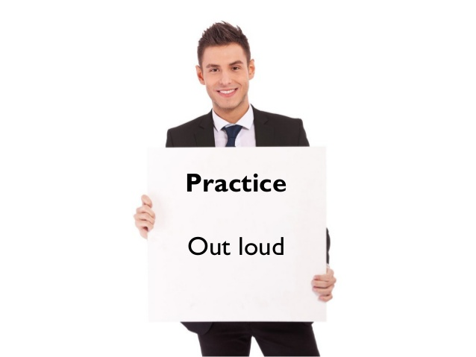

Slide 14
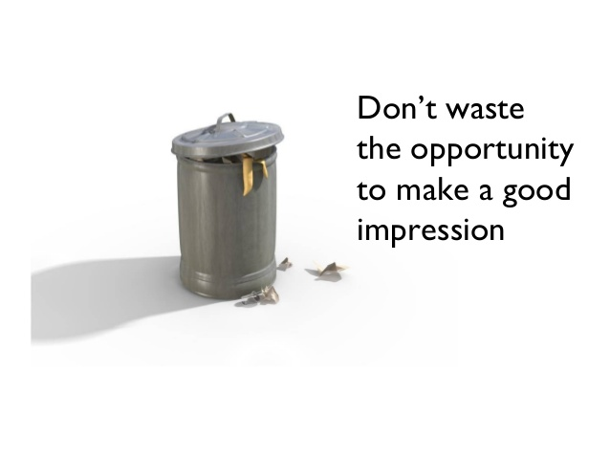

Slide 15
Name, Age & Locality
About Family/Background
Educational Qualification
My Aspiration/Goal
What You like to do/Hobbies
Achievements/Experience
Weakness
Strength

Slide 16
